Slide 1

INTELLIGENT CODING SYSTEM
LAUREN TABER
GRAD 695

Slide 2
Summary
Medical coding is an integral part of the healthcare process.
What is it?
Translation of medical procedures and diagnoses described in a patient’s medical record into codes used for billing and claims.
Why is it important?
Essential for reimbursements
Provides data that can be used for tracking
Promotes consistency throughout the medical field

Slide 3
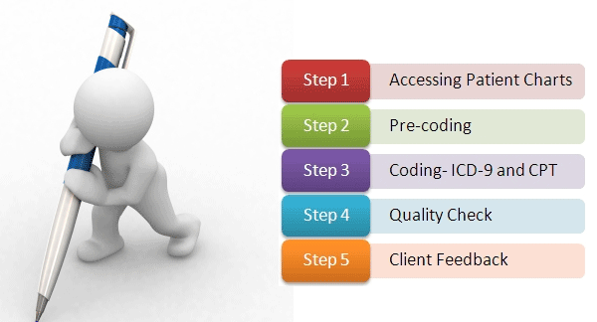
Deliverables
A Search Engine that Provides:
Ability to determine medical codes for procedures and conditions based on keywords or topical searches.
Compliance checks to determine if codes overlap or conflict.
Intelligent features to identify commonly grouped codes and present suggestions to the user.
A reporting feature to present analysis of groupings, processing times, and most used codes.

Slide 4
Justification
Context: Switching from ICD-9 coding system to ICD-10
This application will add value to the healthcare system by:
Reducing the amount of time it takes healthcare workers to determine proper coding for procedures and diagnoses.
Reducing the number of claims that require follow-up or resubmission due to coding errors.
Reducing administrative costs that are going towards training medical coders to use the ICD-10 codes and procedures.

Slide 5
Literature
Benefits
Downsides
ICD-10-CM/PCS code sets will enhance the quality of data for:
Making clinical decisions
Identifying fraud and abuse
Tracking public health conditions (complications, anatomical location)
Improved data for epidemiological research (severity of illness, co-morbidities)
Measuring outcomes and care provided to patients
Designing payment systems/processing claims
(CDC/National Center for Health Statistics, 2013)
High training costs
Possible system performance issues
Significant amount of new data to understand and use

Slide 6
Variables
Dependent
Extraneous
Efficiency
Speed
Time to complete search
Time to find all codes for a particular claim
Accuracy
Conflicts between codes
Claim denials for incorrect codes used
Testing
Insufficient testing could produce poor results in both the search and the suggestions.
Training
Users need to understand how to use the application properly in order to maximize efficiency.
Healthcare Specialty
Different healthcare specialty will have varying amounts of codes used.

Slide 7
Assumptions
Updates to codes and coding policies do not occur more than once a year.
Medical coding is consistent across the country.
Prior patient medical history does not need to be known to determine correct medical codes.
Hospitals will typically have standard practices that will allow correlations to be seen based on historical data.

Slide 8
Approach/Work Plan

Slide 9
Questions?

